Slide 1
Camera Never lies
Peter J Faulks

Slide 2
The Miracle
of
Digital Editing

Slide 3
Contents
Cover Page with images name and title
Table of Contents
Help page
Images or Graphics
Content Report
Impacts on individuals
Impacts on wider community
Censorship
Additional issues
When is it right - covered
Skills, hardware and software identified
Evaluation submitted

Slide 4
Help page
These buttons shown here each link to a certain slide of the presentation. The first button is to go to the previous slide , the second one is to skip to the next slide, the third is to go back to the very first slide and finally the last one gets you to the very last slide.
Custom animation has been used for slide effect, slide transitions were also used to create a greater effect of switching from one slide to the other.
The bibliography/ references are on the second last page and that shows where I got all my images from.

Slide 5
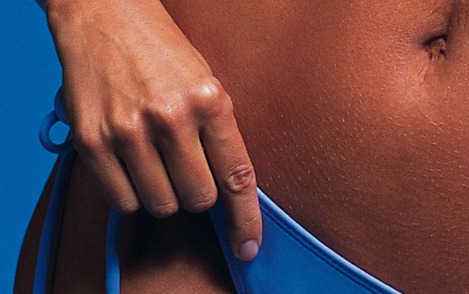
Before

Slide 6
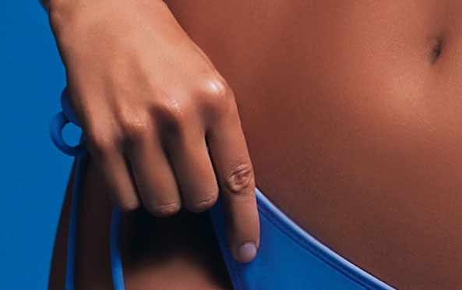
After

Slide 7
Before

Slide 8
After

Slide 9
Before

Slide 10
After
In media, manipulating photographs is common place in many areas such as fashion and cosmetics. Often photo’s of models will be altered to make them look more beautiful and in turn display the products they are selling in the best light. Newspapers and magazines will also sometimes alter images in an effort to create controversy, which will increase their sales.

Slide 11
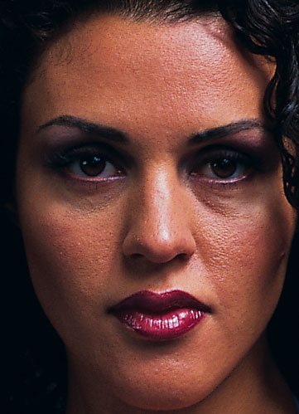
Before

Slide 12
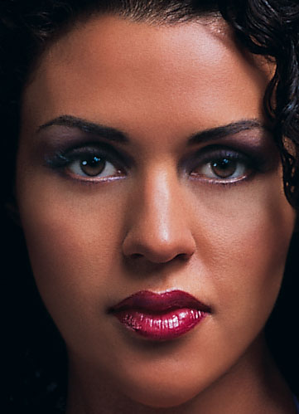
After

Slide 13
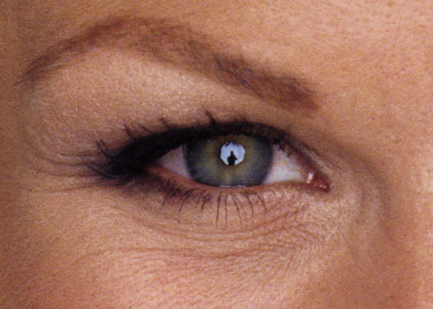
Before

Slide 14
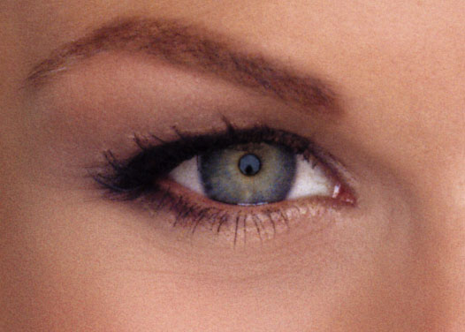
After

Slide 15
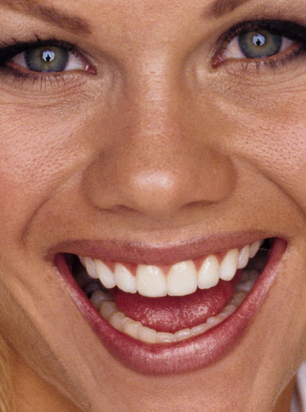
Before

Slide 16
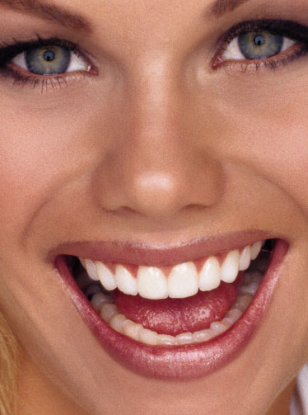
After

Slide 17
Before

Slide 18
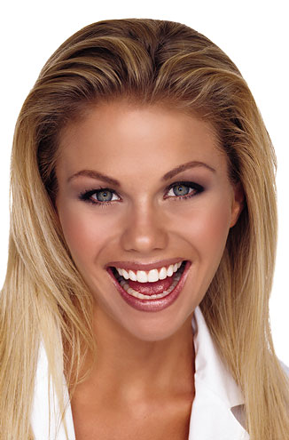
After

Slide 19
What is Photo
Manipulation?
Computer-edited photographs are ubiquitous. We live in an increasingly visual world. As individuals and as a culture, people need to know how to read and interpret visual images
Today’s viewers are sophisticated visually. People can be fooled easily, literally anything can be done to an image to make people believe in certain ways
Problems arise though because the audience think that an image may be real, when editing has occurred

Slide 20
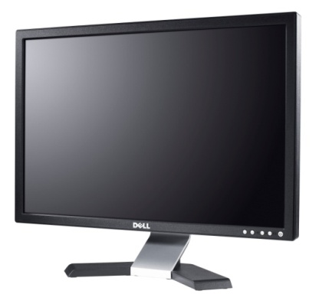
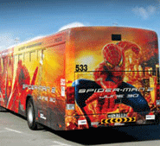
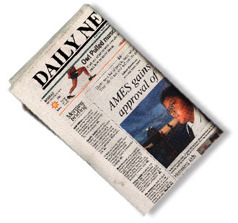
5. Advertising
Advertising is the public promotion of a product or service or company by means of paid announcements so as to affect perception or arouse consumer desire to make a purchase or make a particular action.
In today's society people believe that a photo shown is what the person looks like in real life, but this is not necessarily the case
People are now changing their appearance or the appearance of a object by photo editing software to attract the dominant view in today's society
Most of us are aware that our senses are bombarded on a daily basis with images of impossible beauty, but does that knowledge make us any less susceptible to the desire to compare ourselves and others with these fantasy visions?
Click for more on Advertising

Slide 21
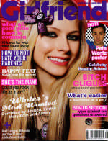
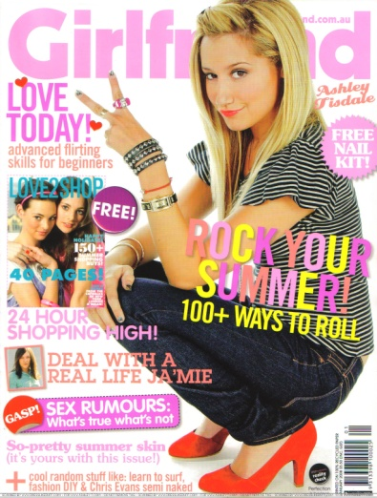
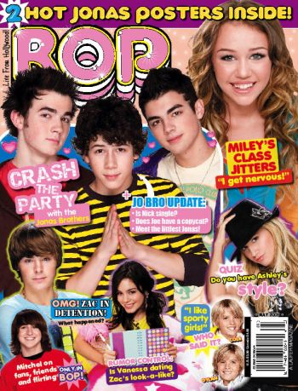
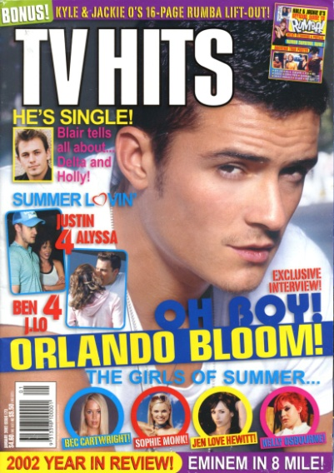
Advertising
Many young teenage females read magazines such as:
Dolly
Girlfriend
TV HITS
Pop
Many of these magazines show insight information on
fashion, celebrates and beauty.
On many covers of teenage magazines, celebrities are pictured such as:
Rachel Billson
Ashlee Simpson
Delta Goodrem
The Veronicas
Scarlett Johansson
Click for more on Advertising

Slide 22
Flawless skin
Bags under eyes have gone
Arm is much thinner
Arm appears
This cover of Redbook magazine shows a heavily re-touched and thinner image of singer and actress Faith Hill. Redbook was accused of contributing to the unattainable body image created by digital re-touching.

Slide 23
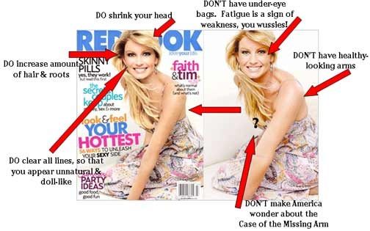
Advertising
Why cant this arm be healthy, to me it looks fine, the question is- “Why does is say she doesn’t have healthy looking arms” if so what is the perfect arms supposed to look like? Is it supposed to look like the arm on the left? Others in the wider community may think that her arms on the left isn’t perfect “So what is it that makes it perfect?” “ Why does this person have the right to say she doesn’t have healthy looking arms?”
Is this what has to be done to every image?
In the advertising industry unless an image is perfect it can not be printed- I believe this is utterly wrong- she looks perfectly fine in the image on the right
In today’s society you will meet the people whom are picky about the way things look but they do not necessarily have the right to say “You don’t have healthy looks arms so we are going to Photoshop these to look healthier. What is this presenting to the audience that unless your arms look the ones on the left image they are not healthy.
Click for more on Advertising

Slide 24
Advertising
Alterations made: - Erased lines around the eyes, - Added hair on top of her head - Removed some of her upper back shoulder area--a little "hump" - Removed part of the upper shoulder and arm so you can now see the shoulder strap on the dress - Made her thinner in the waist - Removed her hand ... no manicure - Made her arm skinnier around the elbow area - Changed her left ear - Removed some of her "sit upon" - Removed some flesh at the back of the dress - Altered the cheeks
Click for more on Advertising

Slide 25
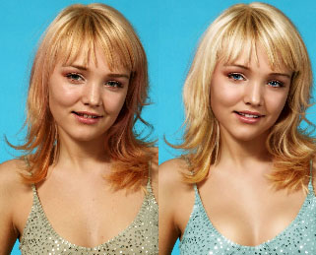
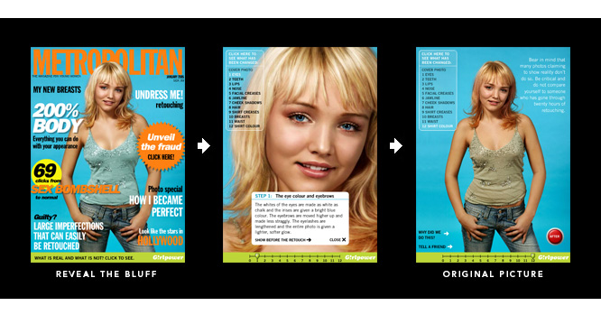
Advertising
This is an image of a 14 year old girl standing in a shirt and blue jeans. The image has been Photoshop manipulated to create the magazine cover of the girl to sell the magazine.
This is the same kind of manipulation that is done in every magazine, every brochure and every packaging label around the globe.
There was nothing wrong with this girl before the photo shopping, she looked pretty. After the editing her face looked too “plastic” and too fake.
I think this manipulation was very inappropriate , especially for her age.
Click for more on Advertising

Slide 26
Please watch the movie
Click for more on Advertising

Slide 27
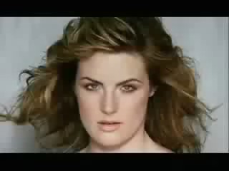
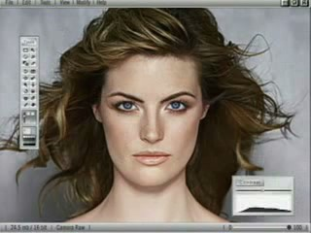
Advertising
As you can see from the movie this women was pretty to begin with she:
Had her makeup done
Had her hair curled
She then had a photo shoot
I personally thought that this women was really beautiful- but wait no… the advertising industry believes that everything has to be perfect!
When this women was digitally manipulated:
Her neck was extended and thinned out
Eyes and hair retouched
Her cheeks had been smoothed out and blush added
Her skin was smoothed out
I believe that the image itself
looks Too plastic meaning
“I can tell editing has been
applied”
Click for more on Advertising

Slide 28
Ask yourself and think: Does she look like the same person from the first image to the final image that was printed onto the billboard?
Click for more on Advertising

Slide 29
Advertising
In the movie when you see this picture, it has been manipulated into a completely different person on a billboard
I believe that advertising industry should be ruthful to their audience. To have this photo of a digital manipulated women on the billboard, I believe that this is wrong.
Is this what the foundation does to your skin?
Although the freedom of photo editors is a cherished value it conflicts with the concern of public health
How damaging is this movie to our modern notions of beauty and our mental well-being on slaught of manipulation- if people thought that this women was how she really looked at the beginning of the movie I believe that the product sales would decrease, because if people found out what had to be done to her to look like a “Barbie”, people would know that the foundation (product being advertised0 is a lie and does not work thus false advertising
This is what your skin looks like with the foundation on
Click for more on Advertising

Slide 30
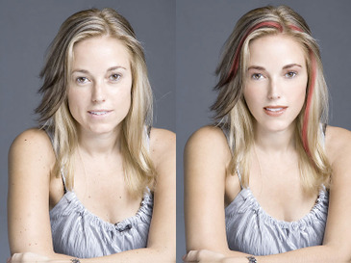
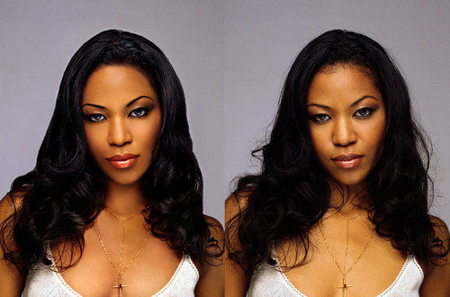
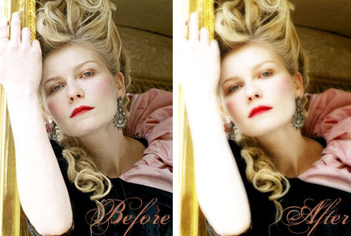
Advertising
When a product is trying to be sold to consumers, the suppliers of this product want the image to be perfect and flawless
In the advertising Industry, it is proposed that without a perfect image, the product will not be sold thus manipulation is needed
People are now becoming aware that photos are constantly being manipulated and the dominant view evokes that digital manipulation should not be done and the true and real beauty is important, not
how much editing one can do to a person
I always think to myself if the photo had been edited or not, although it is hard to tell, I believe it should not be done
Advertising should be about the personal beauty and the actual person not what they look like.
Because so many advertisements are celebrity endorsed, I believe that the images should NOT be edited. So many young people look up to these people, they follow everything about them.
Click for more on Advertising

Slide 31
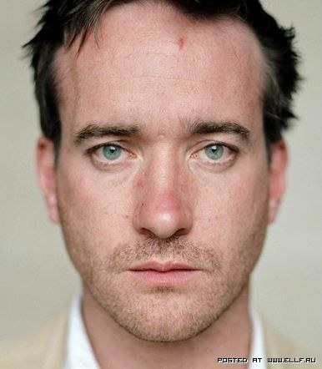
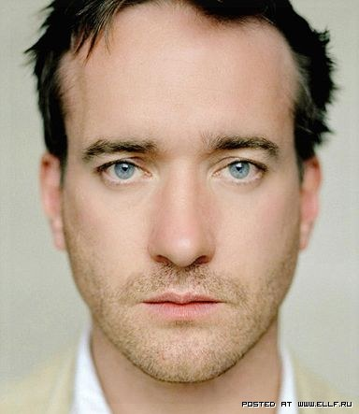
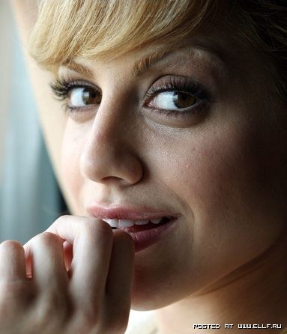
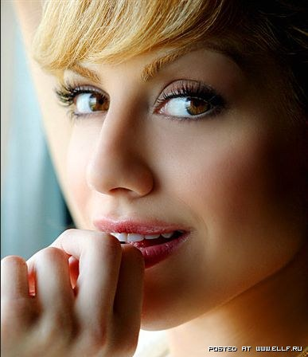
Can you pick which images have been photo shopped?
Every second photo that you saw was photo shopped
Click for more on Advertising

Slide 32
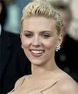
Advertising
Celebrities look divine on the covers of magazines.. Is that them though? How can we tell? But we all know that! We know that photo shopping and airbrushing are what makes the wrinkles, spots and extra fat go away
In magazines today images have been manipulated to portray “what” and “how” to look and “what the ideal size is”
When people flick through magazines they should be aware that the images have been manipulated to have the “ideal image look”.
I believe that in the advertising industry, if a male or female has a scar visible in the shot , it is okay to be removed with the editing tools. Although one may be conscious about a mark/s on their skin the actual pattern of the skin should not be edited out, this should NOT occur
I believe that if the picture needs to be cropped, the colour of the photo needs brightening or darkening- then editing is okay, but when people are smoothing out skin, getting lines on their face and adding blush I believe that this is not the natural beauty and advertising natural should be the way to go!
The actual images shown on this page have been edited not the objects within the image
Click for more on Advertising

Slide 33
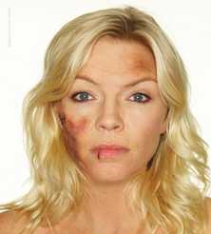
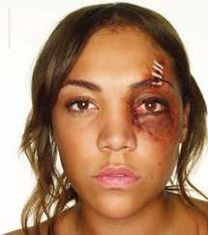
Advertising
To raise awareness of domestic violence, the new Women's Aid campaign features photo shopped UK celebrities. The celebrities have been altered to appear as though they have been beaten, shocking you to realise the importance of domestic violence as an issue
The campaign, which has been photographed by Rankin, uses head and shoulder portraits of famous female faces, made up to show the physical effects of domestic violence. Women photographed so far include Fiona Bruce, Anne-Marie Duff, Anna Friel, Jemma Kidd, Honor Blackman, Fay Ripley, Miquita Oliver and Kate Thornton.
On this issue of advertising I believe it is disgraceful why they chose to add bruises and scars to celebrities faces- although they thought it would get ones attention by celebrity endorsement I think it is stupid and inappropriate!

Slide 34
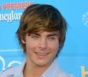
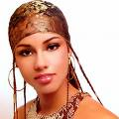
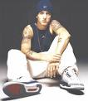
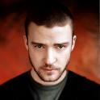
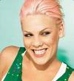
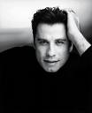
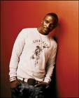
6. Celebrities
A celebrity is a widely recognised or famous person who commands a high degree of public media attention.
Celebrities are shown everywhere around the globe. They are shown in/on:
Magazines
Television
Movies
Packaging
Celebrities are always in the eye of the paparazzi and the wide community around the world
They are idols to many people, they look up to them and admire them and follow the trend that they set and watch their every move
6. Celebrities
Click for more on Celebrities
Click for more on Celebrities

Slide 35
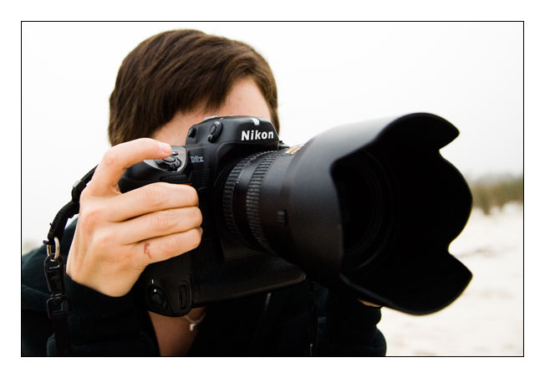
Celebrities
Around the globe today so many people want to be like
someone they are not.
With many photos being printed and accessible for the public to view, many celebrities are under pressure to be “perfect”
By being perfect I believe that photos do not have to be photo shopped and edited. I think that it is purely wrong. Beauty should come from within and shine outwards.
Celebrities are constantly in the eye of media, so they always want to look good in front of the camera.
Click for more on Celebrities

Slide 36
Celebrities
Because so many people look up to and admire celebrities, they watch their every move and attachment begins to form.
When celebrities are shown in the media so many people are pressured to look a certain way, problems like anorexia, depression and bulimia can occur. But wait, these celebrities have been photo shopped and look nothing like their normal self
Teenage females look up to and follow the trends that
these celebrities set. When they see that Rachel Billson
or Nichole Richie has lost weight, the people whom idolise
them loose weight too. It becomes an obsession.

Slide 37
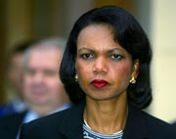
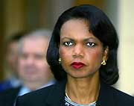
Before
After

Slide 38
Before
After

Slide 39
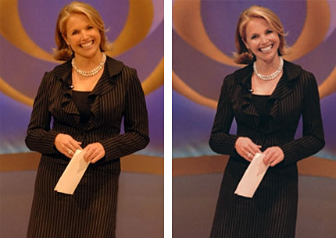
Celebrities

Slide 40
Celebrities
The image of a celebrity is very important. Certain photos are used to enhance ones image. For example one photograph of a celebrity might show wrinkles on their face and then someone would have touched up that photo so that the celebrity has a smooth face so that they look young and beautiful.
However there are other images of celebrities that are definitely not made to enhance their image but to interpret a negative image of them.

Slide 41
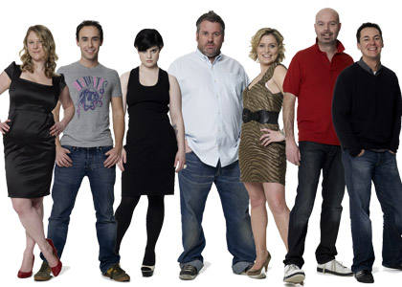
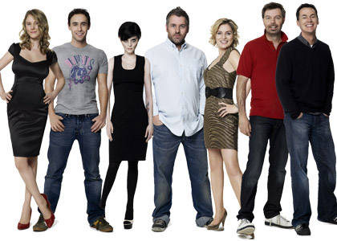

Slide 42
These images have been deliberately manipulated so that these celebrities can look shiny and beautiful other than in their previous photographs.

Slide 43
Politics

Slide 44
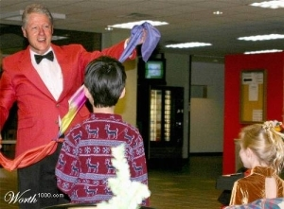
Politicians
Photos for politicians are used to enhance their image just like celebrities. For example the photo with George Bush reading the book upside down as not the real image, the real image however shows it of him reading it the right so he doesn’t look like a complete fool in the previous photo. This photo here of Bill Clinton makes him look ridiculous performing for these kids in a colourful outfit. Yet a photo like this can be used to give him the positive image of the family man; a political man who is good with children. This also could be an image that could appeal to the general public. However this next slide shows a video of Hitler eating a watermelon makes him look absolutely ridiculous, he has become the laughing stock of the world.

Slide 45
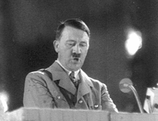
YUM !

Slide 46
Paparazzi

Slide 47
Paparazzi
Generally Paparazzi photographs are made to give celebrities a horrid look. To make a person look worse than what they actually are. For example in this previous photograph of the model one shows the real picture (the right) and the other is the fake (the left). This is shown to emphasize the way in which girls today are obsessed with body image, the fact that girls today are obsessed with being skinny to look good. Today being skinny is valued in our society, no one unfortunately wants to see girls that are real and have shape to them.

Slide 48
Content Report
This PowerPoint shows the effects of new technology in photo editing today. The PowerPoint says the camera never lies true, however the technology given today people can do all sorts of things to images, whether it may be for a good cause or just in order to hurt someone through their appearance.

Slide 49
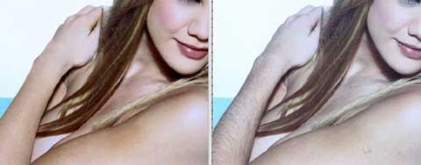
Impacts on individuals
These photographs can have major impacts on the people containing the photograph. A celebrity who would have seen a photograph that didn’t quite look like them or there is some element to that image that was not there would have them worried and upset. That particular image may have a negative affect on the public. Even with politicians if there is any sort of photograph that has a hostile and negative affect towards the public there is no chance of anyone warming to them.

Slide 50
Impacts on wider community
There are some people in the general public who will be affected by certain images. Some images have great influence on people. For example the images women will look at in magazines. The women in the pictures are generally skinny and gorgeous and women are manipulated into believing that this is what we should all look like. These types of images are seen all over the media so people can never not look; it is everywhere.

Slide 51
Censorship
A certain restriction is kept to a particular image of someone. For example covering up a persons private areas in a photo or even blurring a person’s face who does not want to be seen. There are many aspects which people want covered in certain pictures. Sometimes the image may be too graphic for people to see so the image would have to be censored, especially if the media is going to show it to the general public. Better off to save themselves the embarrassment of their “Wardrobe malfunction.”

Slide 52
When is it right? – Covered
It is only usually right to manipulate a photograph for medical reasons. For example if in the photograph there is some gruesome aspect to it and if it is to be viewed by the public then it has to be manipulated in some areas. Same goes if a photograph needs to be censored, there may be some nudity, horrific and graphic aspects that may not want to be seen by the general public. However doing it to deliberately to hurt someone is completely wrong, no one wants to see a horrific image of themselves. People will be embarrassed and upset.

Slide 53
Bibliography/ References
http://images.google.com.au/imgres?imgurl=http://www.24oranges.nl/wp-content/uploads/2007/07/photoshop1.jpg&imgrefurl=http://www.24oranges.nl/2007/07/18/label-for-fake-images-in-dutch-magazines/&h=302&w=400&sz=55&hl=en&start=1&um=1&tbnid=kt71m3oTheaZsM:&tbnh=94&tbnw=124&prev=/images%3Fq%3Dphotoshopped%26um%3D1%26hl%3Den%26sa%3DX
http://www.bbc.co.uk/radio1/surgery/galleries/2960/15/#gallery2960
http://www.hemmy.net/2007/05/25/celebrities-before-and-after-photoshop/
http://rangit.com/computer-graphics/38-of-the-most-admirably-photoshopped-celebrities/
http://www.topsocialite.com/celebrity-photoshop-before-and-afters/
http://www.sheezyart.com/view/255381/

Slide 54
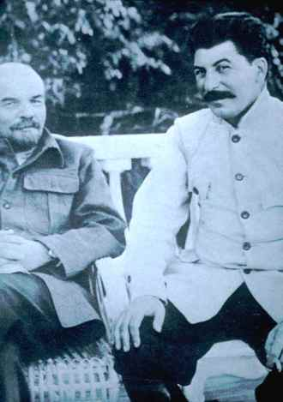
~~Historical manipulation~~
Historical photographs were also manipulated in order for the public to believe that their leaders were with the right people, not at certain events and also at their expected events. These photos were then shown to the public to keep the publics spirits high and to gain support from the public.
Trotsky and Stalin hated each other but to get a higher publicity they were photo shopped together. Stalin is sitting on a bench whilst Trotsky is on a sofa. Evidence is in the arms. Trotsky's arm still looks like its leaning on a sofa.

Slide 55
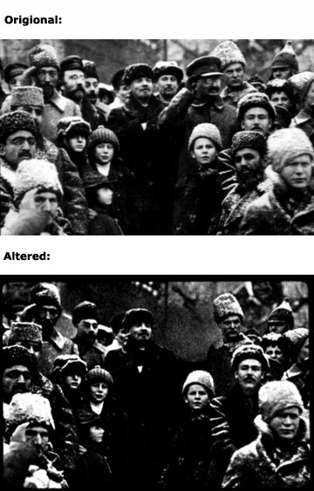
Manipulated Historical Images
In this image Lenin celebrates the second anniversary of the Russian Revolution in Red Square. In the bottom image, his comrade Trotsky is vanished as they weren’t suppose to be seen together as friends due to their different political beliefs.
Historical video clips are also manipulated to be funny and sometimes offensive. The next slide shows Hitler doing something that he wasn’t meant to

Slide 56
LOL!!!

Slide 57
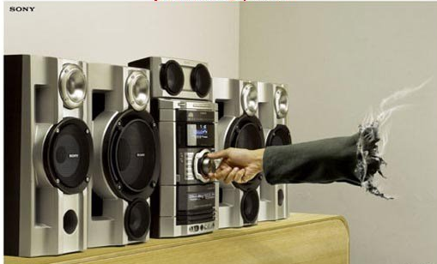
~~Advertisement manipulation~~
When advertisement companies create photos for magazines, newspapers, billboards etc, most of the photographs used are either photo shopped to make the product look like its doing its job (facial creams, shavers etc) or for comical effect.
Such adverts used for comical effect are shown on the right.
It is dangerous to produce photo shopped images whilst advertising a product as it can be classified as false advertising. Under the law the image cannot be excessively edited beyond the true quality of the product. For example, a hair bleaching product cannot show a person with black hair to have perfect blonde hair, this is classified as false advertising.

Slide 58
Advertisements don’t have to be for products. Magazine from covers are also manipulated in order to keep up with religious beliefs. This is also counted as advertisements. This magazine comes from Saudi Arabia, it has been edited so that the lady doesn’t show as much skin to not be ‘sexually eroding’ .

Slide 59
These movie adverts have been manipulated as to not offend the Islamic people.

Slide 60
~~Humour and Amusement~~
Although photos can be edited to be politically correct or to make people believe that something is real. Photos can also be manipulated for comedy and humour as entertainment to people all over the world.
These humorous images are then published in magazines such as ‘zoo’ in the entertainment section. They are also published in other magazines, website and can be put on personal website such as myspace and facebook.
Although some images may appear to be humerous, they may be intended to offend people or certain groups in society.
A photo on its own may not be found humorous until a funny caption is added. Most people have seen the photographs where a simple image or an animal or person is given a funny caption and then inturn becomes humorous and offensive.

Slide 61
Example of Funny Caption
Most pointless family photo

Slide 62
All these images are all fake:

Slide 64
Impacts on wider community
When a fake photograph is published into the world, it can be accessed by millions of people. A lot of people have ‘funny’ photos emailed to them which are most probably edited, if these photos are aimed to insult or abuse certain people, a lot of damage can be done very quickly.
Most commonly, when a photo is edited to insult or to abuse someone, they are high is society or a celebrity. An example of this is when George Bush has pictures of him manipulated to be humorous and even insulting.
Here is an example of a negative manipulation of George Bush. It is more than likely designed to be against Bush and for him to lose some of his supporters.

Slide 66
Impacts on individuals
By editing a photo of somebody in a way that’s insulting or crude can impact that person greatly.
It is bullying ☹
It is more popular to insult a person this way than any other, these images normally end up on website and personal web pages.
Editing photos can be also ethically wrong in some cases.
Using someone else's photo to imitate and abuse can also be very wrong due to copyright laws.
There also can be a greater effect on individuals caused my the paparazzi. As the paparazzi can become very invasive and pushy, they can cause serious accidents, break laws, make the subject feel abused, lead to obsessions or slaking or even death in serious cases such as Princess Diana.
If the subject refuses to be photographed, paparazzi should respect that, it is disrespectful to be so invasive and pushy. It is even more disrespectful to then have these photos published in magazines with such titles as “Bad Hair Day”, “Dog Day Out”, “Day at the Beach” and even articles about the subjects weight or appearance changes.
Paparazzi invading someone’s personal space

Slide 67
Censorship
“Taking photos is fun. What isn't fun is getting sued or arrested. To avoid that, it's worth knowing the legal rights and wrongs of photography.”
Here are just 3 simple laws photographers must follow:
“While taking a picture in a public place is almost always legal, any public place can become a secured emergency area in the event of a police crime scene, disaster, fire or riot. In this case, photography is not legal without permission.”
“Even editorial photographs can come under scrutiny when a caption is added. If the caption implies something false or slanderous about the person in the photo, then it is no longer protected. And the gray area becomes even greyer when you talk about photos as fine art. That is especially true if the artist intends to sell the photograph.”
“Photographers cannot take pictures of a person in a public place without permission if that photo is going to be used to promote any goods or services”.
This is a law book all about the laws for photography ad photographers

Slide 68
Additional issues
Humans are not the only things that are manipulated. It is often seen that a simple animal is blended into another to create a strange creature. These creations can be humorous and also scary but they show how effective photo manipulation is. To blend two different animals into one image requires a lot of patience and artistic views. These image have specific detail and are quite impressive when studied.
It is debatable wether or not these images are allowed or not. Because it is extremely difficult to ask the animals permission to be photo shopped, the decision is up to the original photo holder.

Slide 69
Is Seeing Believing?
Living in a Digital World
Created by:
Theresa Redmond
Visual Arts teacher
Peoples Academy
Middle Level
2007

Slide 70
YOUR ASSIGNMENT:
This power point is designed for you to navigate on your own.
Go through each slide and, using the hyperlink connections to attach to the web, browse the suggested web sites.
As you explore, please complete the “Scavenger Hunt” handout.

Slide 71
As you work, remember three basic essential questions.
ESSENTIAL Questions
How is Adobe Photoshop used today?
2) What are the effects of manipulated images?
3) How do these images shape beliefs about body image, the political process, and our perceptions of reality?

Slide 72
Remember the Dove Beauty Video?
Click the link below to view:
http://www.campaignforrealbeauty.com/flat4.asp?id=6909

Slide 73
Jennifer Aniston sued Redbook
magazine for manipulating her
picture without permission.
Read more about the Aniston Scandal at:
http://www.frankwbaker.com/aniston.htm

Slide 74
Check out other
manipulated magazine covers!
http://www.frankwbaker.com/isbmag.htm

Slide 75
http://www.poynter.org/content/content_view.asp?id=15422&sid=29
“Are you an avid sports fan, like me?
OK sports fan, now here is another question:
Does it matter at all to you that the telling and powerful cover photo from Superbowl XXXV was manipulated to fit the cover of Sports Illustrated?”
Go to the website below and, under resources, try
CROPPING an image!

Slide 76
Visit this website for a step-by-step digital manipulation demo.
Click on “Retouch”
http://demo.fb.se/e/girlpower/retouch/

Slide 77
Greg’s Digital Retouching Portfolio
For some people, digital manipulation for
commercial companies is a full time job.
Check out Greg’s work at:
http://homepage.mac.com/gapodaca/digital/digital.html
Before
After

Slide 78
Learn more about National Geographic Magazine’s “Photo of the Year” at:
Photo Fact...
Or, Photo Fiction?
http://news.nationalgeographic.com/news/2002/08/0815_020815_photooftheyear.html

Slide 79
http://news.com.com/2300-1026_3-6033210-12.html?tag=ne.gall.pg
Click either link to see more
“PHOTOS THAT LIE”
http://www.sree.net/teaching/photoethics.html

Slide 80
In other news?
Examine Ethical Issues in Digital Manipulation
Go to:
http://www.frankwbaker.com/isbnews.htm

Slide 81
Photo-manipulation circa 1860
For the whole story on
Abe’s new bod and more
manipulated pics,
click
the link below…
http://www.cs.dartmouth.edu/farid/research/digitaltampering/

Slide 82
http://www.snopes.com/photos/politics/kerry2.asp
This digital composite of Senator John Kerry and Jane Fonda sharing a stage at an anti-war rally emerged during the 2004 Presidential primaries as Senator Kerry was campaigning for the Democratic nomination.
BUT IT IS FAKE!
Click the link below for the whole story and original pics…

Slide 83
Click on either link below to read about this fake photo:
http://www.sree.net/teaching/lateditors.html
http://www.frankwbaker.com/alteredphotostory.htm

Slide 84
Watch an online video about photo manipulation in News:
Click here:
http://www.aish1.com/videos/PhotoFraud.swf

Slide 85
“Photography has always been awarded a special status for truthfully recording the world. But that doesn't mean all photographs, all the time.”
Check out the PBS Image Lab
and
watch the video!
http://www.pbs.org/ktca/americanphotography/features/digital_essay.html

Slide 86
http://www.nationalgeographic.com/ngkids/0104/foolery/tips.html
Spot Photo-Fakes!
Get media savvy and learn how to
spy a fake photo….
Click the link below:

Slide 87
Spot the Mistake
Not all photo shopped images are good quality. Sometimes it is able to spot mistakes which is due to ‘bad editing’.
These mistakes can give the magazine bad reviews as it is evident that the photo is fake and by doing so will bring down the whole quality of the article, magazine and images. Most other photos in the magazine will not be believed and the magazine may eve n lose valued readers.

Slide 88
When is it right - covered
Most students at schools have some kind of access to a photo editing program. Most of the time, the students only use these programs to edit their own photos which are then uploaded on their personal web pages such as myspace and facebook.
It is acceptable to a wide society when the edited photos do not offend or imitate anyone. The photos must not be copyrighted and the final product cannot be rude, offensive, ethically wrong or against any law
I have done a few quick examples and one in detail using a mix of a few photos, Corel, boredom and a lot of free time.

Slide 89
3 images all to be cropped but one
The uncropped image is normally a background

Slide 90
Using Corel, I cropped, moved, edited and blended all these images together to create a totally different image.
This image was very easy to create and took me a maximum of 5 minutes.
This type of photo editing is accepted as it is only for personal usage and doesn’t offend anyone, plus its fun to create.
This type of photo manipulation is acceptable by most people.
This is an image of a celebrity being manipulated in order for her to have smoother skin, and look more glamorous. This is done on Adobe Photo Shop

Slide 91
The Camera Never Lies
By Alexander Sardo
2A AIT 2008

Slide 92
Help
Previous Slide: takes you to the previous slide.
Home: takes you to the contents page.
Help: take you to this page.
Next Slide: takes you to the next slide.

Slide 93
Contents
Introduction
What is Image Manipulation?
Use of Image Manipulation
Analogue and Digital
Hardware
Software
Law and Ethics
Examples
Help

Slide 94
Introduction
“The Camera never lies” is a famous statement, however does it still hold true? In our modern world pictures are often seen in newspapers, magazines and the internet altered from their original form.
The truth is that the camera never actually does lie, the changes made are the result of image manipulation.
Image manipulation has been around nearly as long as photography has. A famous example of this was Leon Trotsky a rival politician of Joseph Stalin. After Stalin seized power he ordered that all photos of Leon Trotsky be doctored to remove him.

Slide 95
What is Image Manipulation?
“Photo manipulation is the application of image editing techniques to photographs in order to create an illusion or deception (in contrast to mere enhancement or correction), through analog or digital means.” – wikipedia
No dictionary could give a clear definition for image or photo manipulation however I believe the wikipedia one gave the most informative and concise explanation.
The only area that becomes hazy is “in contrast to mere enhancement or correction”. Where do you draw the line between enhancement or correction and illusion or deception, for example if a you see a picture of a model in a magazine and she has had her skin “touched up”, her hair colour made more vibrant and some of her features, such as her lips, made bolder, is that enhancement or deception? This is deception as you are not seeing a true representation of the person in the photo.
Enhancement is more clearly defined as changing the quality of an image, for the better, without altering the picture itself. For example if you have a picture of , say you and your friends, and everybody in it has “red eye” it would not be image manipulation to remove that. This is enhancement as the people in the image are not being altered merely corrected.

Slide 96
What is Image Manipulation?
“Photo manipulation is the application of image editing techniques to photographs in order to create an illusion or deception
This print (Library of Congress, Prints & Photographs Division) appears to be of General Ulysses S. Grant in front of his troops at City Point, Virginia, during the American Civil War. Some very nice detective work by researchers at the Library of Congress revealed that this print is a composite of three separate prints: (1) the head in this photo is taken from a portrait of Grant; (2) the horse and body are those of Major General Alexander M. McCook; and (3) the background is of Confederate prisoners captured at the battle of Fisher's Hill, VA.
Notes:
96

Slide 97
Uses of Image Manipulation
Image manipulation has many uses, mostly in media and film for a variety of reasons and also used very often on the internet.
On the internet image manipulation is mostly for humour but also to show off people’s ability to vastly alter images while maintaining their realism. This is often called photoshopping in reference to photoshop a popular image manipulation program made by adobe.
A fantastic example of this is in the political arena. Politicians who spoke at separate events will be placed next to each other on the front cover of a newspaper creating the illusion that they are at the same event. The newspaper might not necessarily claim they’re at the same event but they will not say that the politicians weren't at the same event either. However if the newspapers claim that they were at the same event and the truth is they were on opposite sides of the country, the newspapers can be sued, so most prefer to create the illusion and leave the rest to the readers.
In the film industry image manipulation is common place as it is used to create spectacular special effects that drawn in massive crowds, all eager to see “their hero’s next big adventure”

Slide 98
Analogue and Digital
There are two basic kinds of image manipulation, digital and analogue.
Analogue is the most basic form and usually consists of working with the negatives‘, cutting and splicing them together then developing the manipulated negative.
Digital is the more advanced method, utilising computers and software to digitally alter an image. Analogue editing is limited in how far you can manipulate an image but digital editing can go much further and is the more available form of editing, requiring only a computer and the correct software, as opposed to your own dark room.
VS

Slide 99
Hardware
If you chose to go the digital route you will need some specific things and this will cost you, depending on the level of editing you wish to achieve. For a start, a good computer is required with a reasonably powerful graphics card, a fair bit of RAM and plenty of space on the hard drive so you can save your work (images can take a lot of space).

Slide 100
Software
Once you have a computer capable of running a digital editing program you need to decide what program you want to use. If you have never used digital editing software it’s best to start slow and use something like Corel PHOTOPAINT which comes bundled with the Corel DRAW graphic suite.
As you get better you could move to something like Adobe Photoshop. Whatever you use its best not to go out and buy a program intended specifically for professionals, not saying Adobe Photoshop isn’t meant for professionals, it’s one of the best programs available. However there are many complex editing programs that are about as user friendly as Microsoft access and are intended for people with years of experience.
Video
This is a video I found on the internet

Slide 101
Law and Ethics
There are no laws preventing the manipulation of images. However if an image depicting someone is altered and is considered to be detrimental the creator can be sued as this is classed as slander or libel.
From an ethical perspective many people have questioned whether it is right to manipulate pictures of famous people, models and anyone else who may be considered a role model to young children or teenagers.
Wherever you look in society there is a drive to be “slim”, this is usually driven by society’s definition of “beauty”. The people in the world who best display this “beauty” are usually models, movie stars, singers etc, but is it really ethical to show pictures of these people when they have been manipulated to the point were they are so skinny they border on anorexic?
When young people see pictures of their role models they will most likely attempt to imitate them in every way, especially their appearance. It is this exposure of manipulated images in the media that have lead experts to blame them for the rise in teenage anorexia and bulimia.

Slide 102
Examples

Slide 103
Bibliography
http://ifelse.co.uk/images/photoshopped_model.jpg
http://www.funpic.hu/funblog/allatok/allatok.html
http://en.wikipedia.org/wiki/Photo_manipulation
http://graphicssoft.about.com/od/digitalphotoethics/The_Ethics_of_Digital_Photo_Manipulation.htm
http://graphicssoft.about.com/gi/dynamic/offsite.htm?zi=1/XJ/Ya&sdn=graphicssoft&cdn=compute&tm=1&f=20&su=p284.8.150.ip_&tt=14&bt=1&bts=1&zu=http%3A//www.webster.edu/%7Ebarrettb/journal_ethics.html

Slide 104
Images or Graphics

Slide 105
CONTENT PAGE
Impacts on individuals
Impacts on wider community
Censorship
Additional issues
My Opinion
Evaluation

Slide 106
Impacts on individuals
The impact on the individuals can
be extreme for example in the photo this implies that Mr Bush is not able to be president of the U.S.
Has their every been a female president??

Slide 107
Impacts on wider community
In this photo, impact on the wider community
Is showing that they are being run by a monkey.
Photo manipulation can have a massive affect s on the community and can change and persuade people points of view either against or with a certain groups .

Slide 108
Censorship
Censorship can be harmful or sensitive by law.
“Typically censorship is done by governments, religious and secular groups, corporations, or the mass media, although other forms of censorship exist.”

Slide 109
4. What is Photo
Manipulation?
Photo manipulation is a powerful tool to enhance photography or computer-generated images.
In shops today people are able to buy digital editing programs, however most people believe that they can perform some kind of photo manipulation, but this is not the case.
Proper photo manipulation takes highly specialised skills and an enormous amount of time to perfect
Photo manipulation is not just about using the technology, it is about understanding our society
Some say that photo manipulation is okay and that an image is allowed to deliberately mislead or misrepresent another person, I believe that it is okay but only in some cases
Click for more on Photo manipulation

Slide 110
7. Additional Issues
Humour
Humorous images are created to make an audience laugh or prove a point about two images
Political
In the image shown on this slide, George Bush is shown reading to a young girl at school. The photo has been edited so that the book is upside down, this provokes that George Bush is foolish and unintelligent - which he is not
Provoking Badness/ Evil
In the first image Oj Simpson has his photo taken when he was arrested. The image shown in the magazine has obviously been edited. As one can notice the image has been darkened to draw attention to the death-ness that Oj Simpson created.
Click for more on Additional Issues

Slide 111
Additional Issues
Historical
Trotsky and Stalin hated each other but to get a higher publicity they were photo shopped together. Stalin is sitting on a bench whilst Trotsky is on a sofa. Evidence is in the arms. Trotsky's arm still looks like its leaning on a sofa.
Is used to show controversy of people from the past that had issues between them
Wedding Photos
If an important person in the wedding could not make it on the day the photos were taken, photo shopping would be applied. The wedding photo is for personal use only so it is up to the individual to add in people or props that were not there on the day
Click for more on Additional Issues

Slide 112
Additional Issues
Personal
In today's society there are many photo booths in shopping centers and game places too. Friends and family take photos and get them printed out. But the latest case is to edit these photos. Like the photos shown you can add in text, colour the image, add hearts, bows, butterflies anything you want really.
When editing these photos you are not actually changing what the people look like in the photo (e.g. retouching skin colour or smoothing out the skin or thinning someone out), only adding in things to make it look pretty and presentable.

Slide 113
8. When is it right for photo manipulation?
If someone was trying to share the beauty and wonder of an image like brighten it up, enhance the image or take away the blur to it is visible
I believe that it is not right when people are trying to create an image from one that is already in existence
If something is added that wasn’t there in the original scene, you have crossed the line from a photograph to a fictional one, this may be not okay depending on its purpose
As long as the artist does not try to mis-represent what they are doing and methods are completely explained in the caption, it is an aesthetic judgment as to their success or failure.
I think the acceptance and popularity of images like this are mostly due to the proclivities of the viewer, they would rather be entertained and don't care that much that they were fooled
When people correct, manipulate and enhance images in Photo
shop, we must understand with the questions of ethics and aesthetics.
Ethics is a set of moral principles or values
Aesthetics deals with the nature of beauty, art and taste and things that are in pleasing appearance
In photo manipulation, there is almost no limit in which can be done
to an image. The question is when does the pursuit of aesthetics violate
our ethics.
Changes can be made to images that are undetectable, so much so that
there is now a discussion that photographs will no longer be allowed as evidence in courts of law
Click for more on When Is It Right

Slide 114
When is it right for photo manipulation?
Positives
In Hollywood at the moment there is a big craze about the Photo Shop Diet, and may celebrities are adopting this technique
Many people have an artistic imagination and have great computer skills, wit this knowledge and passion people come up with some pretty weird images, this has also become a hobby of many others around the world today
Click for more on When Is It Right

Slide 115
When is it right for photo manipulation?
Negatives
When everyday people are just plain bored on the computer, some of them copy images from the internet and edit them on an editing software, the people from the images have not said that they could manipulate them into different people- this is going against the persons own rights
In some of the images on the following slide, the person shown in real life is on the left hand side and the manipulated one is on the right hand side
The images shown on this slide are quite breath taking, they have been manipulated to a point that there is hardly anything left of the women
Click for more on When Is It Right

Slide 116
On the left, is the person in real life- on the right , is a manipulated version
If people edit celebrities to an extent of humiliation- I believe they should not repost these recreated images on the internet

Slide 117
9. Censorship
The right to take a photo is limited by government security and peoples privacy
The right to sell a photo is limited by the peoples privacy, publicity, copyright of artwork and trademark
There are no general laws against taking photos. Photography is considered an artistic expression which, if anything, is protected not prohibited
The laws that do affect photographers are mostly about the subject of the photo, The laws are then defined to the subjects property and prevent you from “stealing” what is valuable to someone else
There are many things that can be photographed such as:
People, children, celebrities, Law Enforcement Officers, Accidents, fires, crimes, businesses, public property, airports, bridges, infrastructure, transportation, houses, residents and public art but there are some consequences to this and some rules you have to abide by.
“Copyright” is “the right to copy”. This right is a legal construct. Without copyright people would be able to copy your art and claim it as their own- and even get payment for it. If someone
wants to use your work, they have to get your permission
talk about laws of photography
-fun
Legal rights
Give examples-
Copyright laws

Slide 118
How easy photo tampering is: ONE face, many identity’s
BEING LARRY IS EASY!!!!!!
He Got to star in Lord of the rings
He got to be a postman for a day
He Likes to do a little bit of yoga occasionaly
HE WAS EVEN SHREK
He EVEN WAS on the front cover of TIME!
This is Larry

Slide 119
Before
After

Slide 120
Historical manipulation
When I first heard about manipulation I believed that it was a new age issue. But after researching photo tampering throughout history, I found out that the actual first manipulation occurred as early as the 1860’s only a few decades after Niepce created the first photograph in 1814. The manipulation of digital images is becoming more common now and there are many questions to be answered like is it ethically correct. Throughout history manipulated images have confused people and have made people believe things that are not true.
In 1930 Stalin had a fight with one of his commissars and he was removed from the original photo. Stalin frequently air- brushed his enemies out of photographs

Slide 121
1860- u.s president lincoln
Lincoln
Calhoun’
Different head
Same body
Same body
The portrait of U.S President Abraham Lincoln is actually two photo’s compressed together. It composes of Lincoln’s head and the Southern politician John Calhoun’s body.

Slide 122
Elsie Wright and Frances Griffiths
To prove their mother wrong, Elise Wright and Frances Griffiths decided to take Mr. Wrights camera and take photo’s of the fairies down by the lake in 1917. Soon after the photo’s had been developed people began whispering and talking about these two girls who had pictures of themselves, with what seemed to be ‘real fairies’.

Slide 123
These photos seemed to captivate the English who were still bruised and battered from the world war, and many people believed in these photo’s to reaffirm their belief in goodness and innocence. A local photographic expert was shown the photo’s and he claimed that they were real photos, untouched and genuine!

Slide 124
After years of lies and speculations, in 1981 the cousins finally admitted that 4 of the pictures were indeed fakes and the fairies were actually paper cut-outs from a fairy book. The two girls had stuck the fairies down with hat pins. But they insisted that the one of the photo’s was real, and no tampering had occurred. Still to today, the images remain one of the most famous hoaxes of all time!
The 5th image that the girls claim is real.

Slide 125
Code of Ethics of Photojournalists
Must be accurate and comprehensive in the representation of subjects.
Resist being manipulated by staged photo opportunities.
Be complete and provide context when photographing or recording subjects. Avoid stereotyping individuals and groups. Recognize and work to avoid presenting one's own biases in the work.
Treat all subjects with respect and dignity. Give special consideration to vulnerable subjects and compassion to victims of crime or tragedy. Intrude on private moments of grief only when the public has an overriding and justifiable need to see.
While photographing subjects do not intentionally contribute to, alter, or seek to alter or influence events.
Editing should maintain the integrity of the photographic images' content and context. Do not manipulate images or add or alter sound in any way that can mislead viewers or misrepresent subjects.
Do not pay sources or subjects or reward them materially for information or participation.
Do not accept gifts, favors, or compensation from those who might seek to influence coverage.
Do not intentionally sabotage the efforts of other journalists.

Slide 126
Random Photo Shopped Picture

Slide 127
Laws Of Photoshop
No additions or deletions to the subject matter of the original image.
No excessive lightening, darkening or blurring of the image
No excessive colour manipulation
Only minor Photoshop work should be performed in the field.
ALLOWED:
Cropping Adjustment of Levels to histogram limits Minor colour correction Sharpening at 300%, 0.3, 0 Careful use of lasso tool Subtle use of burn tool Adjustment of highlights and shadows Eye dropper to check/set gray
NOT ALLOWED:
Additions or deletions to image Cloning & Healing tool
Airbrush, brush, paint Selective area sharpening Excessive lightening/darkening Excessive colour tone change Auto levels Blurring Eraser tool Quick Mask In-camera sharpening In-camera saturation styles

Slide 128
Example of how photo tampering effects individuals
In April 2004, mingling with the locals, Mr. Boudreaux scribbled on a piece of card “ Welcome Marines” and gave it to some children who posed with him. He then e-mailed the image to his family and his friends.
The image then made it to the internet where bloggers changed the image. Commentators across the internet believed Boudreaux was playing a nasty trick on kids who couldn't read English, and he was immediately deemed as insensitive, ignorant and just plain stupid.
The Council on American-Islamic Relations stumbled across the image and demanded an inquiry. Many different versions of the image appeared all over the net causing much debate.
Soon after, he learned he was being investigated by the Pentagon. His reputation was ruined.

Slide 129
Law
Of Photoshop

Slide 130
How Photo Tapering Affects individuals
Driver's licenses, security cameras, employee IDs and other digital images are a foundation of proof and the fact that they can be easily altered is a big deal. People are able to change their identity quickly, and soon every image could become a potential suspect.
Altered photos could harm the innocent, free the guilty, or simply cause havoc in the judicial system.
If people believe in a photo, some body’s reputation could be ruined
By manipulating a photo, without somebody's consent can be a form of bullying and they may be effected so badly they might need to see a councilor
People will start to not believe what they see in the media because most of what we see it not true anyways

Slide 131
Thanks to Photoshop, this may be you one day!
PhotoShop is so easy to use, one day your best friend might create a ‘funny’ image of you and post it all over the net. Ethically that is not right.

Slide 132
Censorship
Here are 3 simple rules that photographers must
follow:
“While taking a picture in a public place is almost always legal, any public place can become a secured emergency area in the event of a police crime scene, disaster, fire or riot. In this case, photography is not legal without permission.”
“Even editorial photographs can come under scrutiny when a caption is added. If the caption implies something false or slanderous about the person in the photo, then it is no longer protected.”
“Photographers cannot take pictures of a person in a public place without permission if that photo is going to be used to promote any goods or services.”
Ethically, you must have your own morals and standards when editing an image. Creating something that in your mind is perfection but in reality will never happen is ethically not correct. We are in an age where digital media is becoming more popular, and photo shop is used constantly, and it is up to individuals to stop themselves from going way to far and create something that is not reality.

Slide 133
Random Photo Shopped Picture

Slide 134
Advertising and Photoshop
When is it right?
Advertisements always use Photoshop to make the product seem perfect, but it is only right when the image is still believable.
It is only right, when the advertiser acknowledges that photo shop has been used on the product
When it’s deliberate, when you can the changes present
When they tell you
When is it wrong?
When its misleading
When you can’t tell the difference
When the people in the image seem flawless and fake
When people believe that if you buy the image you will look like that

Slide 135
Advertising and Photo Shop
This high-resolution, digital photographic image was created from several elements for a dance ware manufacturer . A high-resolution, digital photograph of the girl was composed into a 3D generated image of a stage with curtains. Photo manipulation and composition to create advertising.

Slide 136
Advertising and Photo Shop
This adorable baby group is the result of photo-manipulation accomplished after the model photography shoot. The baby in blue is silhouetted and imposed from a completely different photograph, as is the computer. The babies and papers were covered in crayon markings and needed extensive retouching. The original background was also removed and replaced with the bright yellow.

Slide 137
Impacts on Wider community
Images are sent around the world so quickly, that by the time you realise it was the wrong thing to do to manipulate an image it may be to late.
People make judgements very quickly
People may not buy women's magazines anymore because a lot of the stories and images are fake
People don’t trust the media and each other any more
Fights take place because of lies and manipulation

Slide 138
How Photoshop effects Celebrities
George Clooney
Jack Nicholson
Nicole Kidman
Anthony Hopkins
Adam Sandler
Will Smith
Angeline Jolie

Slide 139
How Photoshop Effects Celebrities
Photos of actress Kate Winslet were enhanced before they appeared on the cover of GQ magazine.
The healthy-sized actress has been celebrated and criticized at different times by the media for having a typical womanly figure.
Of the cover photo Winslet said, "I actually have a Polaroid that the photographer gave me on the day of the shoot…I can tell you they've reduced the size of my legs by about a third. For my money it looks pretty good the way it was taken.“
Winslet said she was "not a fan of Photoshop, preferring to remain as natural and real as she is in the flesh."
Many stars in the public eye are watched and judged on appearance
Makes celebrities feel as though they have to look a certain way all the time

Slide 140
Kate Winslet
Much more weight around the leg
Shorter legs
Same upper body
After- Sends a bad image as she is very skinny. Again makes it look like all celebrities are like that.
Before- much healthier image. A lot more girls can relate to body size

Slide 141
This is no living doll, it is Janet Jackson promoting her new album. Photo Shop has been used obviously as it looks nothing like Janet Jackson, and her skin is smooth, with no flaws.

Slide 142
Left, America Ferrera on the October 2007 cover of Glamour. At right, Ferrera at the Creative Arts Primetime Emmy Awards.
Notice with the picture on the right, Ferrera has become very skinny and her skin flawless.

Slide 143
Nikki Webster
Skin has been
smoothed.
All flaws removed

Slide 144
Nicolette Sheridan
All Flaws have been removed from skin
Eyes are more vibrant
Hands are smooth, no veins are showing

Slide 145
How Celebrity Flawless Effects Public
By altering images of celebrities, it sends a misleading message to the public, that appearance means everything.
The media portrays celebrities to be flawless, where in actual reality that perfection does not actually really exist.
The pictures that are retouched should not be published, as celebrities are human beings, and at they are not going to look beautiful every minute of every day.
By altering photos of celebrities to make them look skinnier or make them have flawless skin is not right and changing the meaning of the picture in unethical as a photo journalist.
Because people want to be as flawless as celebrities many go on diets and have plastic surgery.

Slide 146
Random Photo Shopped Picture

Slide 147
When is it Right to use Photoshop?
?
For personal use- if you want to change your own personal features or put yourself on a different background
For School purposes- projects, assignments
For humor- If you are creating an humorous image of someone else, you must tell them
If you are going for a job interview and you need a photo of yourself, I believe its ok to retouch some of your flaws, but not to the extent where you can’t recognize yourself.
To enhance something that is already in the picture to make it more vibrant and visible
To get rid of red eye
To make the image lighter and brighter
If someone is making a rude gesture in a photo, you are able to edit them out
If you want to create a family portrait, even though some members are deceased

Slide 148
Software
There were many new skills that I learnt which are photographic skills, computer skills, and I learnt how to use PowerPoint and words documents
The Software was fairly new to me and it took me a while to understand where I was going and which buttons were where. The software I used was Adobe photo Shop and Microsoft Office Base.
The hardware that you need to use for photography are tripod, extra lenses, effect lenses, portable/ wireless laptop, usb drive

Slide 149
Additional Issues
Animal Manipulation- believe it or not but people actually manipulate images of animals. Although animals may not be able to talk, ethically is it right? Personally I think animal manipulation is very humorous, and I don’t believe people should have any problems with them
Bullying and fights- People will fight over images and graphics which may have been manipulated because those pictures can be racist, mean or send a bad message
Politics- People going for the other opposition team may Photoshop images to make the other team member seem stupid or idiotic.

Slide 150
Table of Contents
Cartoons
Celebrities
Government Support
Humiliation
Software Used
Hardware Needed
Help Page
Go to Help page

Slide 151
Cartoons
Cartoons are manipulated to create a false sense of enjoyment to a movie or cartoon. The characters in the movie cars was created by the use of Photoshop as designs.

Slide 152
Celebrities
Celebrities are widely abused to there perfect body and face. The image on right shows the comparasin between 2 photo’s. one was done in Photoshop

Slide 153
To support government
The composite, which carried a false
Associated Press credit, purported to show John Kerry and Jane Fonda,
known for her stance against the Vietnam War, sharing a speaker's
platform at a 1971 antiwar rally.
Conservative groups circulated the manipulated photo for several days,
and it appeared in several publications before it was revealed to be a
fake, apparently stitched together by someone opposed to Mr. Kerry's
presidential run.

Slide 154
Government Humiliation
President bush on the 11/9/2001 was shown here in the paper that day a photo of Mr Bush with his book supposedly upside down. The media exploited this image as it was the day of the twin towers terrorism attack. The original photo (top) was manipulated to show the book upside down. What if that photo had floated around two days before the general election and there wasn't time to say it's not true? He would have been removed from his presidential role.
2/6/2008
Joel Grinham

Slide 155
Software Used
Adobe Photoshop
Corel Photopaint
Software Cinema Photoshop
Telegraphics
Photoshop Express
2/6/2008
Joel Grinham

Slide 156
Hardware Needed
Graphics Card
Computer
Laptop
RAM (2GB)
2/6/2008
Joel Grinham

Slide 157
Thank You
2/6/2008
Joel Grinham

Slide 158
Which one looks better to you?
THE END

